Slide 1
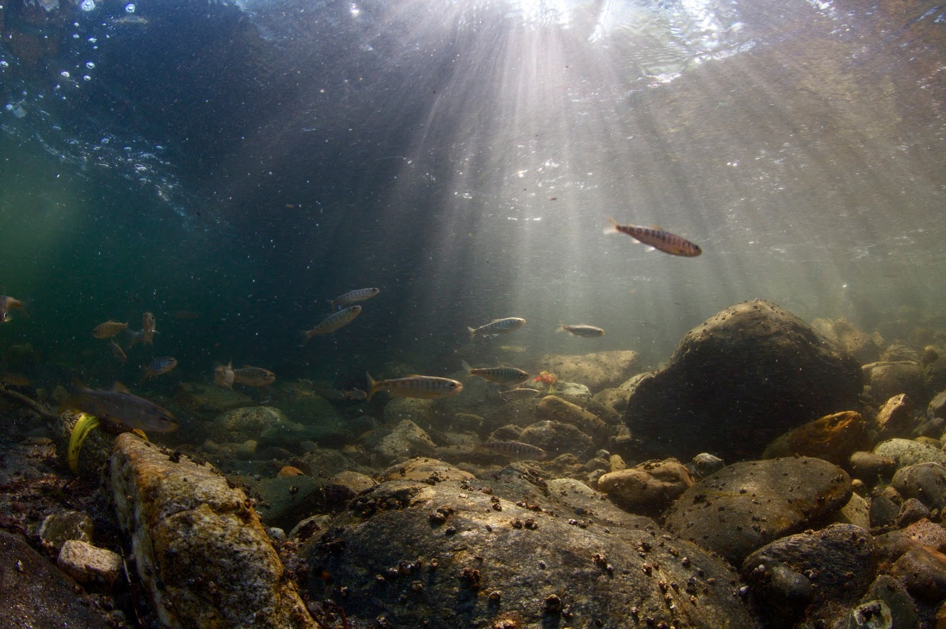






Developing and delivering surrogate wild Chinook and steelhead
Karen Cogliati, David Noakes, Cameron Sharpe, Rob Chitwood, Ryan Couture, and Carl Schreck

Slide 2
Acknowledgments
The Surrogate Team:
Courtney Danley
Olivia Hakanson
Kate Self
Heather Stewart
Julia Unrein
Eric Billman
Volunteers and work study students
OHRC Staff:
Joseph O’Neil
Joyce Mahr
ODFW staff and hatchery managers
Funding:
Army Corps of Engineers

Slide 3
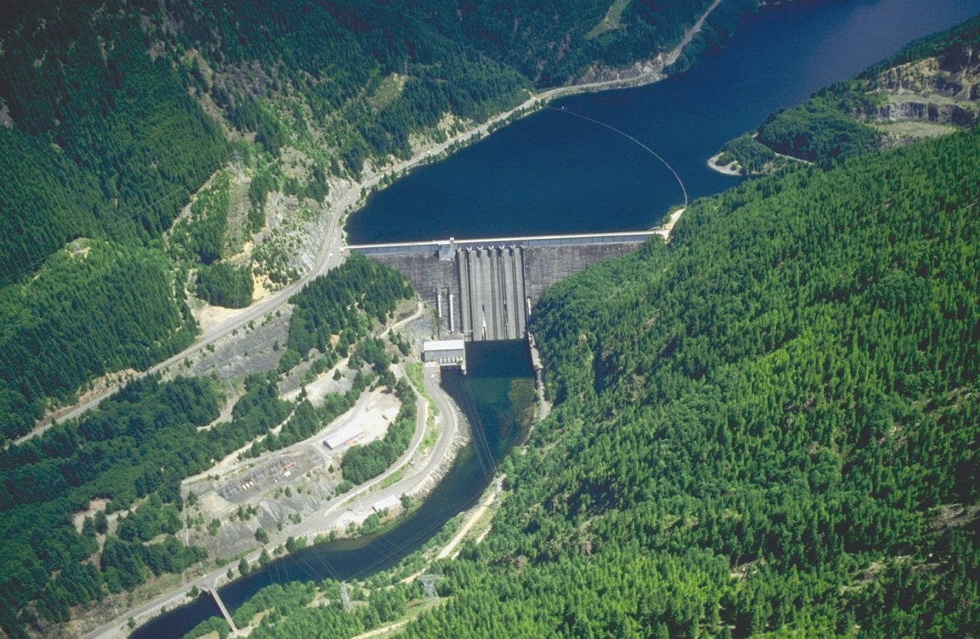
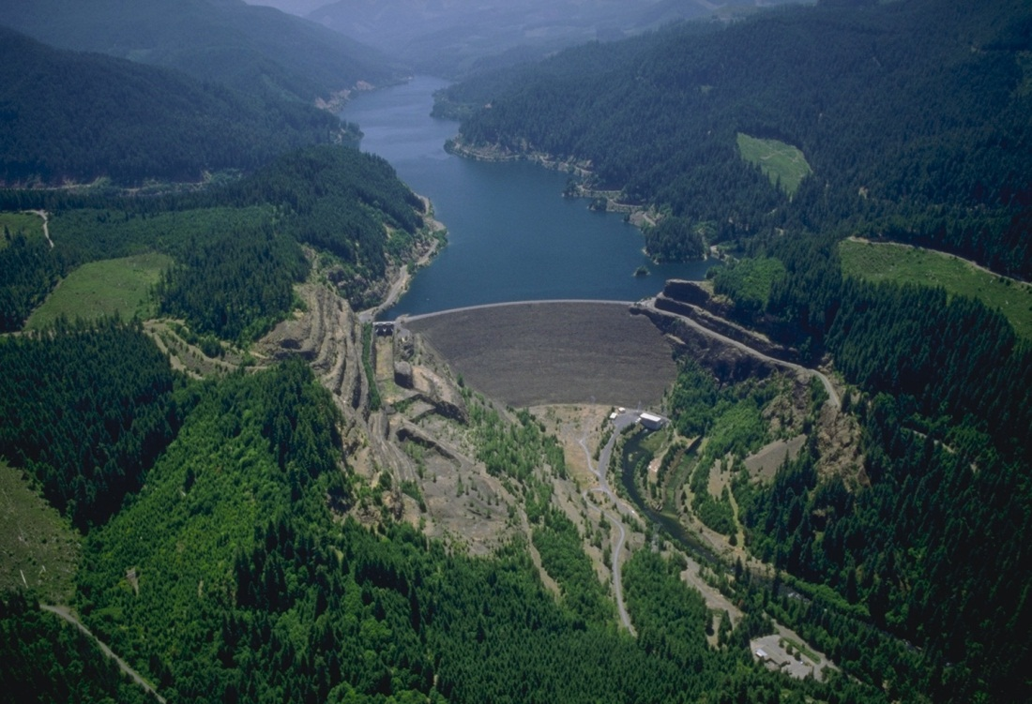
Project Dams
Barrier to fish movement
Studies evaluating juvenile movement to and through WVP dams
Detroit Dam
Cougar Dam

Slide 4

ESA listed Salmon and Steelhead
Limited availability of fish
Hatchery-origin substitute for research
Hatchery phenotype ≠ wild phenotype

Slide 5
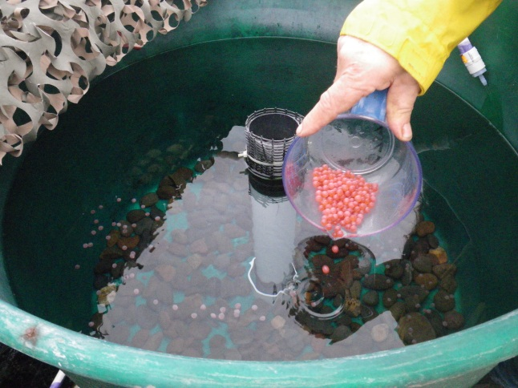
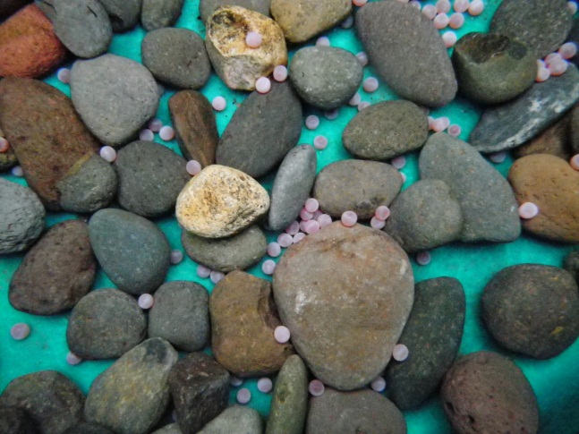
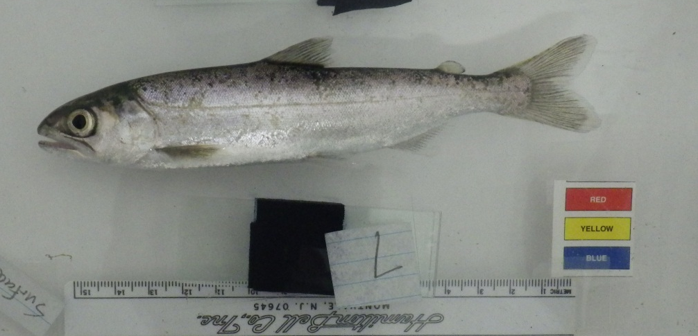
Surrogate Wild Fishes
Juveniles reared in artificial environments that emulate specific wild phenotypes
Spring Chinook and winter steelhead

Slide 6
The Surrogate Project
  Goal:
  Rear and deliver surrogate fish to researchers
  Objectives:
  Develop rearing protocols that produce more wild-like fish
  Establish criteria to evaluate the quality and phenotypic accuracy of our surrogates
  Describe phenotypes of naturally-reared fish to establish target phenotypes
  Describe phenotypes of hatchery-reared fish to determine the effects of conventional hatchery protocols on phenotypes

Slide 7

Step 1: Coordinate with researchers
Planning 1-2 years in advance of fish needs
  Rear from eyed-egg or green egg stages
Information required from researchers:
  Brood stock
  Time of release
  Target size at release

Slide 8
Step 1: Coordinate with researchers
Key players
  USACOE project leaders
  RME researchers
  ODFW Hatchery leadership

Slide 9
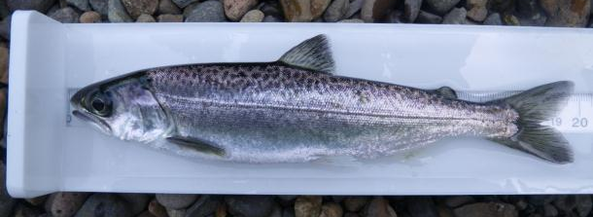
Spring Chinook upcoming deliveries
Location | Brood Year | Deliverable type | Target date | Target size (mm)
McKenzie | 13 | Yearling | Feb 2015 | 125
South Santiam | 13 | Yearling | Feb-Apr 2015 | 140
MFW | 13 | Yearling | Spring 2015 | 125
McKenzie | 14 | Sub-yearling | May 2015 | 65
McKenzie | 14 | Sub-yearling | Sept-Oct 2015 | 125
South Santiam | 14 | Sub-yearling | Sept-Oct 2015 | 198
MFW | 14 | Sub-yearling | Fall 2015 | 198
North Santiam | 14 | Yearling | Spring 2016 | 160

Slide 10
Spring Chinook 2014 deliveries
Stock | Brood Year | Target type | Target size (mm) | Status
McKenzie | 12 | Yearling | 125 | Delivered March-May 2014
McKenzie | 13 | Sub-yearling | 145 | Pit tagged and picked up Oct 2014
McKenzie | 13 | Sub-yearling | 65 | Pit tagged and picked up May 2014
MFW | 13 | Sub-yearling | 65 | Delivered March 2014
South Santiam | 13 | Sub-yearling | 165-200 | Delivered Oct 6 2014

Slide 11
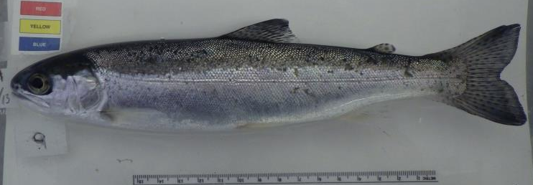
Winter steelhead 2014 and 2015 deliveries
Location | Brood Year | Deliverable type | Target date | Target size (mm)
North Santiam | 13 | Yearling | June 2014 | 140
South Santiam | 13 | Yearling | October 2014 | 140
South Santiam | 13 | 2-yr smolt | Feb – Apr 2015 | 180
North Santiam | 14 | Yearling | Fall 2015 | 140
North Santiam | 14 | 2-yr smolt | Spring 2016 | 180
South Santiam | 14 | 2-yr smolt | Spring 2016 | 180
Notes:
Indicate that also produced large number not delivered because order cancelled. Foster 500 detroit 13,500 detroit 1,500 foster 2,000

Slide 12
Step 1: Coordinate with researchers

Slide 13

Step 1: Coordinate with researchers
Sometimes fish needs change…
  Fish numbers
  Migratory phenotypes
  Target sizes

Slide 14
Step 1: Coordinate with researchers
We prepare for a change in requests… within reason
More advanced notice
=
Better able to adapt to change

Slide 15
Step 2: Rear high quality surrogates
  Goal:
  Rear and deliver surrogate fish to researchers
  Objectives:
  Develop rearing protocols that produce more wild-like fish
  Establish criteria to evaluate the quality and phenotypic accuracy of our surrogates
  Describe phenotypes of naturally-reared fish to establish target phenotypes
  Describe phenotypes of hatchery-reared fish to determine the effects of conventional hatchery protocols on phenotypes

Slide 16
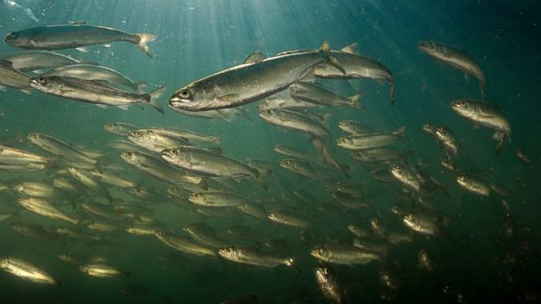
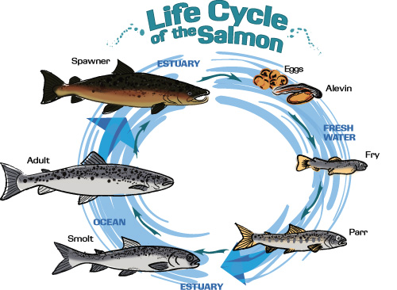
  Establishing target phenotypes
Migrating juveniles when released
Rear them and they will migrate
UC Davis

Slide 17
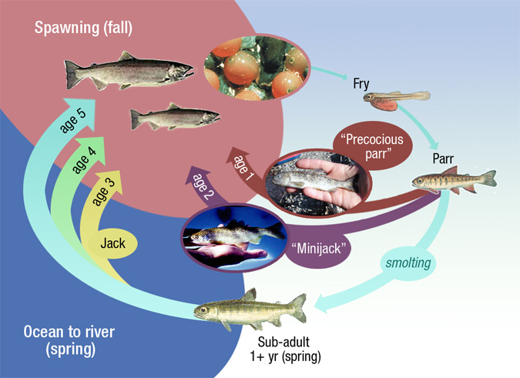
  Rear, release, migrate…not quite
NOAA Fisheries

Slide 18
  Avoid early maturation and they will migrate…But when?
Fall migrants
Spring migrants
Migrate out of tributary in late Fall and early Winter
Spring Chinook
  Subyearlings
Winter steelhead
  Yearlings
Migrate out of tributary in late Winter and early Spring
Spring Chinook
  Yearlings
Winter steelhead
  2-year smolts

Slide 19
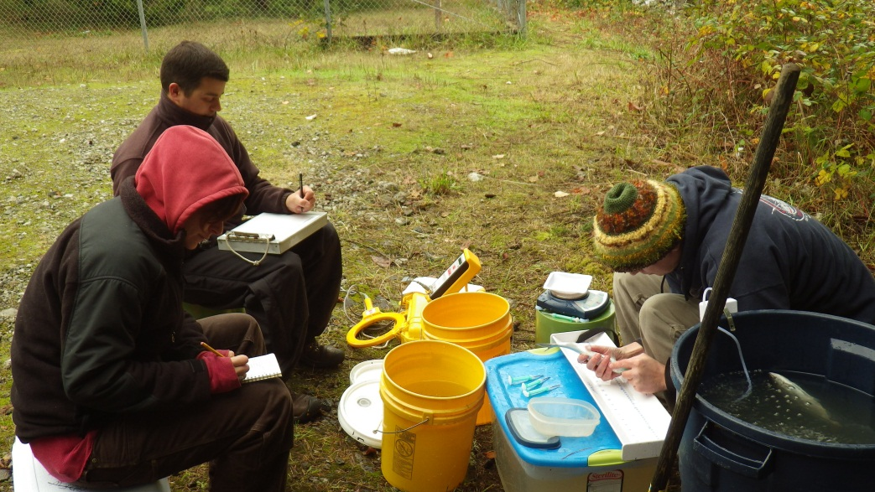
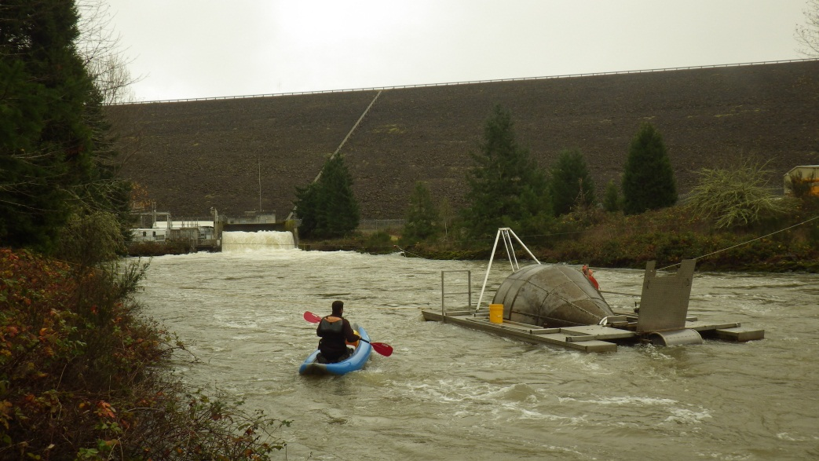
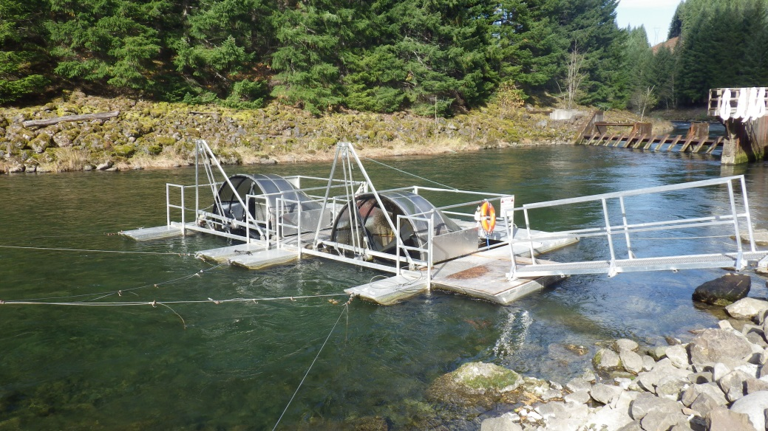
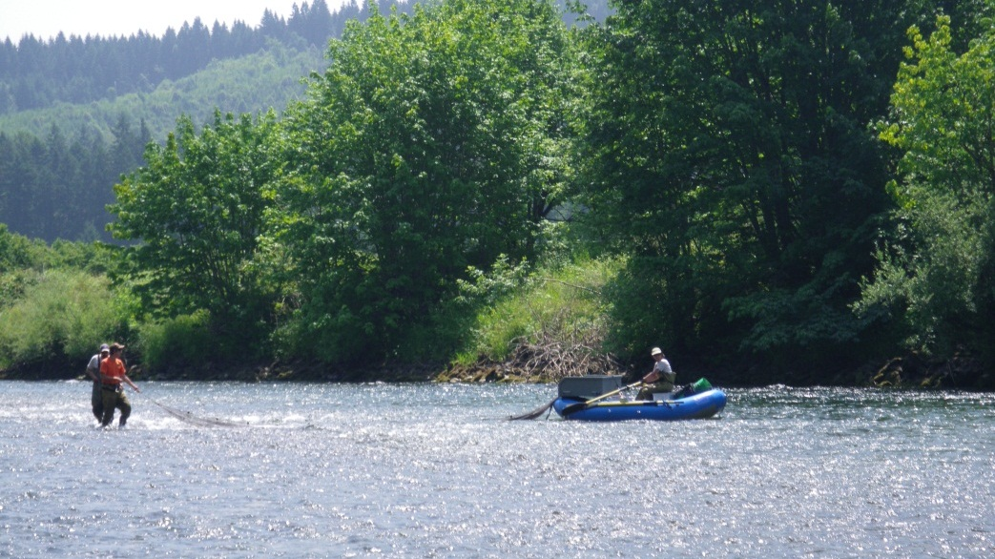
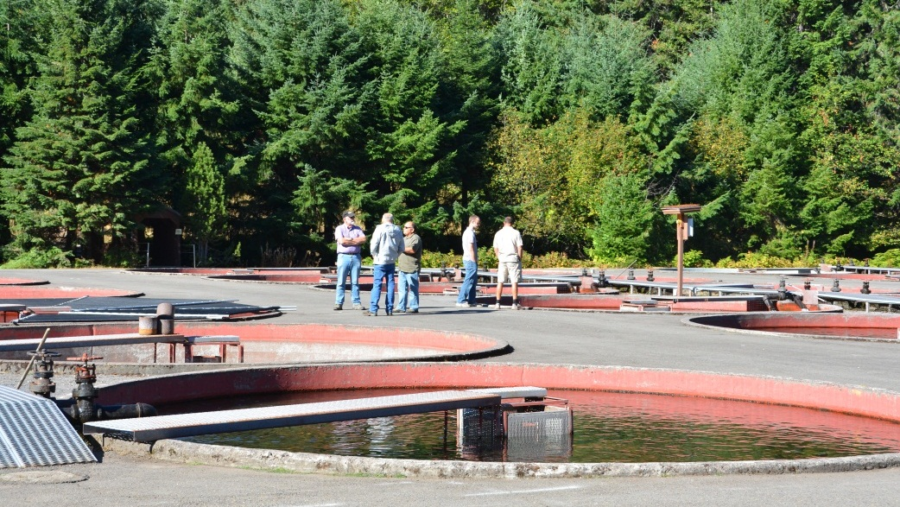
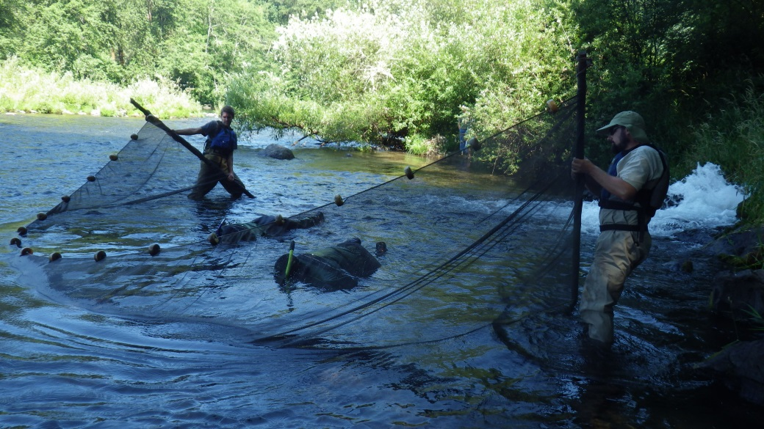
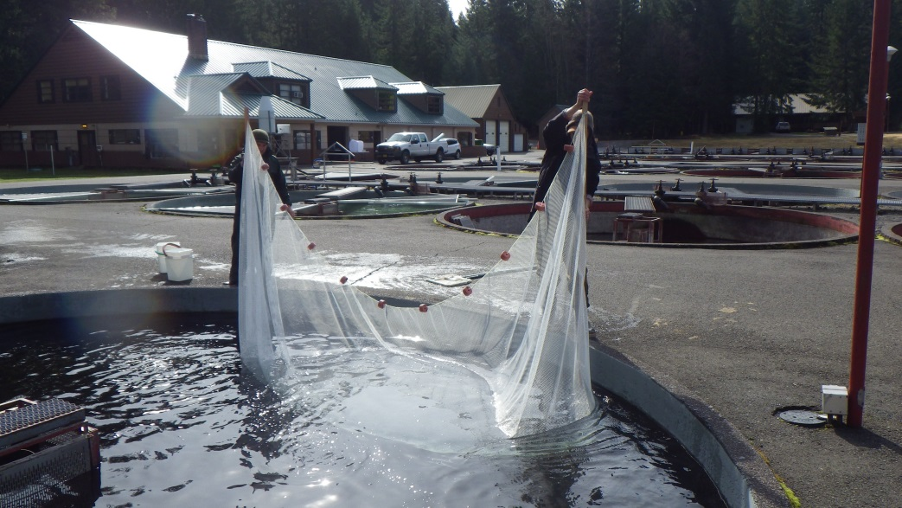
  Establishing target phenotypes

Slide 20
  More than just size
Location | Brood Year | Deliverable type | Target date | Target size (mm)
McKenzie | 13 | Yearling | Feb 2015 | 125
South Santiam | 13 | Yearling | Feb-Apr 2015 | 140
Dexter | 13 | Yearling | Spring 2015 | 125
McKenzie | 14 | Sub-yearling | May 2015 | 65
McKenzie | 14 | Sub-yearling | Sept-Oct 2015 | 125
South Santiam | 14 | Sub-yearling | Sept-Oct 2015 | 198
Dexter | 14 | Sub-yearling | Fall 2015 | 198
North Santiam | 14 | Yearling | Spring 2016 | 160

Slide 21
Growth trajectories
Natural growth parameters for Spring Chinook
Fall
Spring
N D J F M A M J J A S O N D J F M A M
Data from Monzyk and Romer

Slide 22
Growth trajectories
Surrogate BY13 growth trajectories for Spring Chinook
Fall
Spring
Incubation and rearing temperature
Diet
N D J F M A M J J A S O N D J F M A M

Slide 23
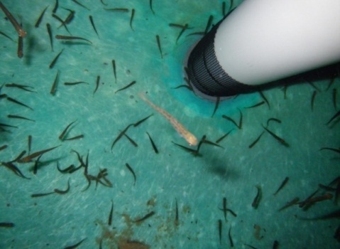
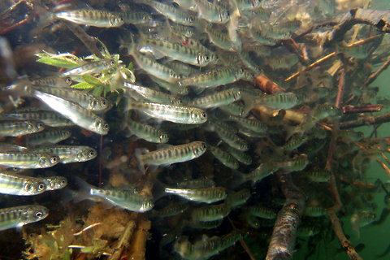
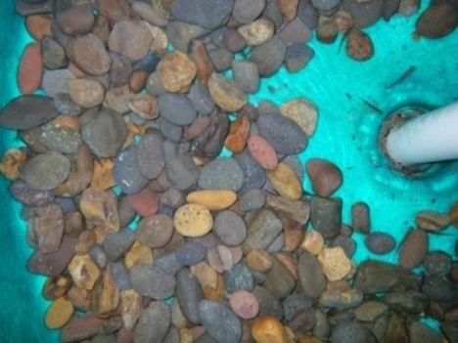
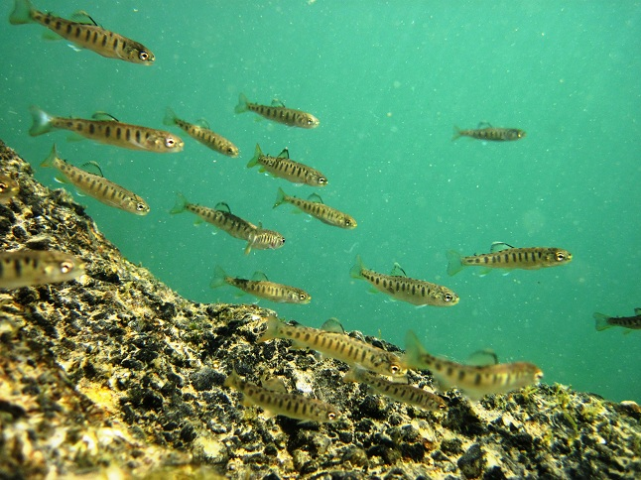
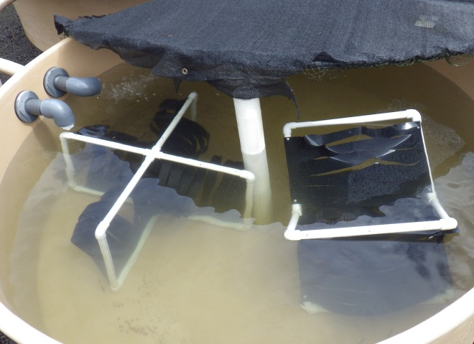
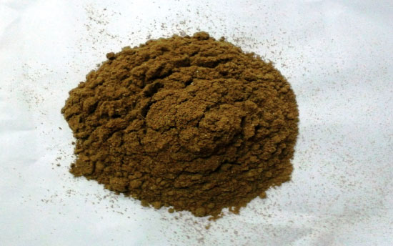
  Altered rearing environment
Tank environment
Density
Diet

Slide 24

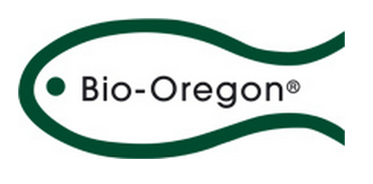
  Low-lipid starter diet
Five experimental diet treatments:
  4-6% lipid
  8-9% lipid
  11-12% lipid (equal to wild Chinook grower diet)
  18-20% lipid from Bozeman
  18-20% lipid - commercial Bio-vita starter
Bozeman Fish Technology Center
In collaboration with Bozeman Fish Technology Center

Slide 25
Growth trajectories
Surrogate BY13 growth trajectories for Spring Chinook
Low lipid starter diet benefits on growth?
Fall
Spring
Very low frequency of precocial males
N D J F M A M J J A S O N D J F M A M

Slide 26

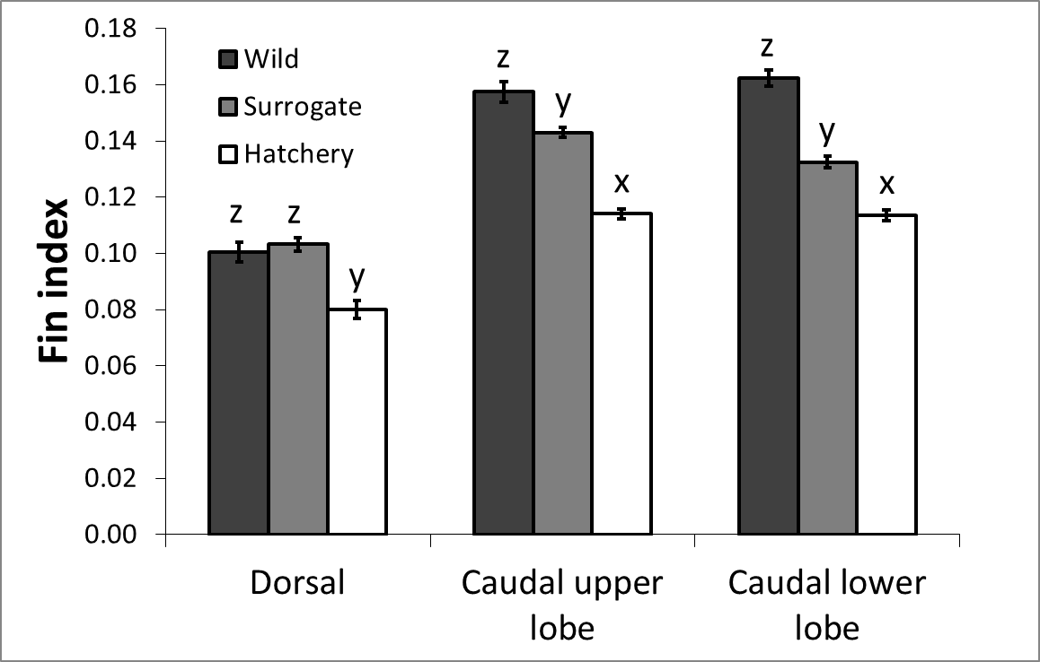

Effects of rearing on fish quality
Fin index is a measure of fin erosion
  = Fin length / fork length

Slide 27
Fin quality
Fin index is a measure of fin erosion
  = Fin length / fork length

Slide 28
Fin quality
Fin index is a measure of fin erosion
  = Fin length / fork length

Slide 29
  Other phenotypic traits
Body condition/lipid content
Smolt readiness
Migratory behavior
Morphology
Brain size
Foraging efficiency

Slide 30
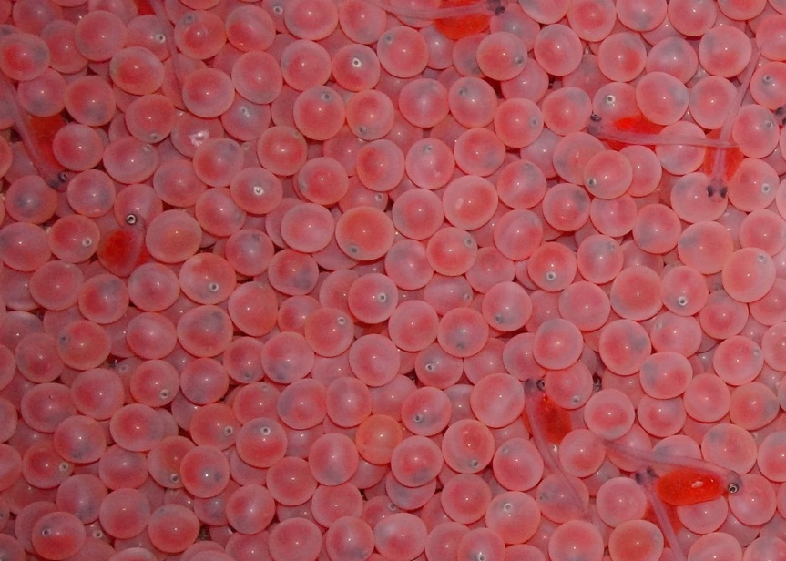
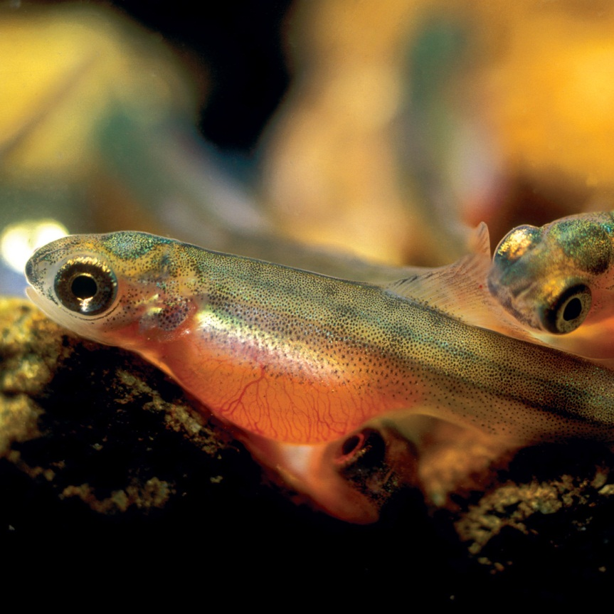
  What about the fish?
Phenotypic differences expressed early in life…
Different life history tactics expressed later?

Slide 31


  Behavioral phenotypes
Vertical self-sorting at emergence
Surface and Bottom fish
  Persistent behavior

Slide 32
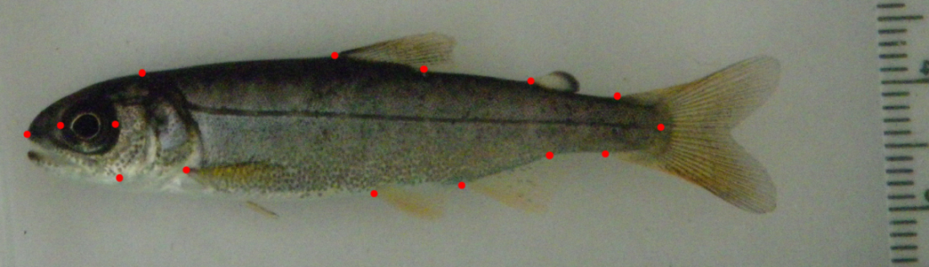
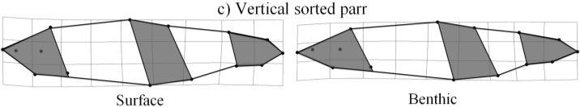
  Morphological phenotypes
Surface vs bottom
  Shorter head
  Smaller eye
  Deeper body
  Shorter caudal peduncle
surface
bottom
Morphological variation at 55 mm FL
Unrein et al. in prep

Slide 33
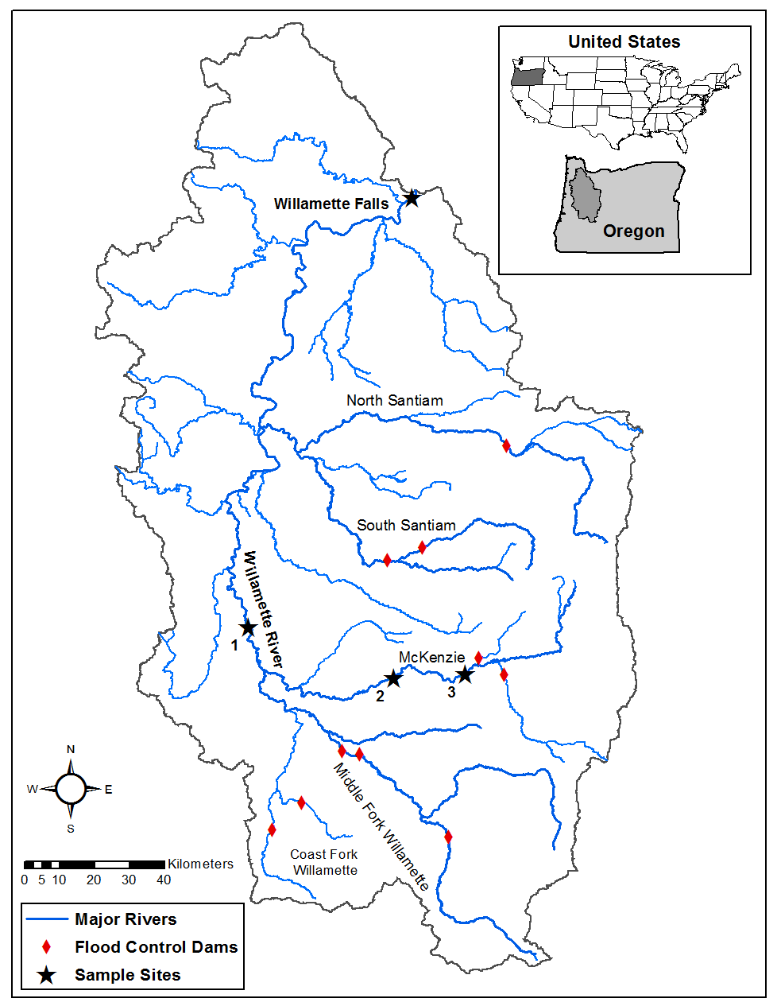
  Translate to migration behavior?
Fall or spring migrants
Upstream or downstream parr

Slide 34

  Translate to migration behavior?
Billman et al. 2014; Unrein et al. in prep

Slide 35
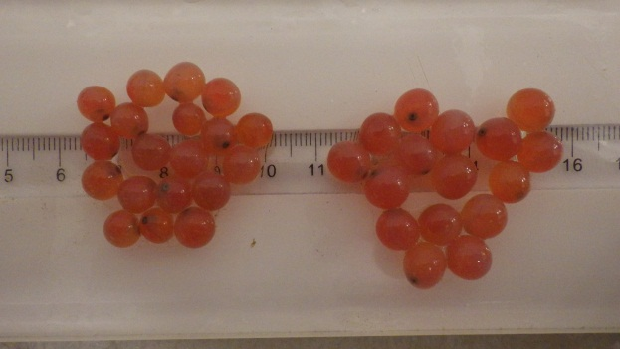
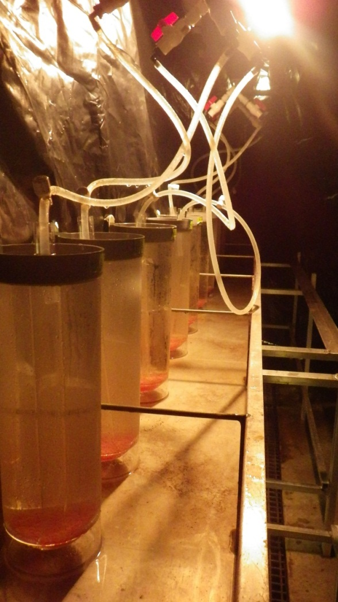
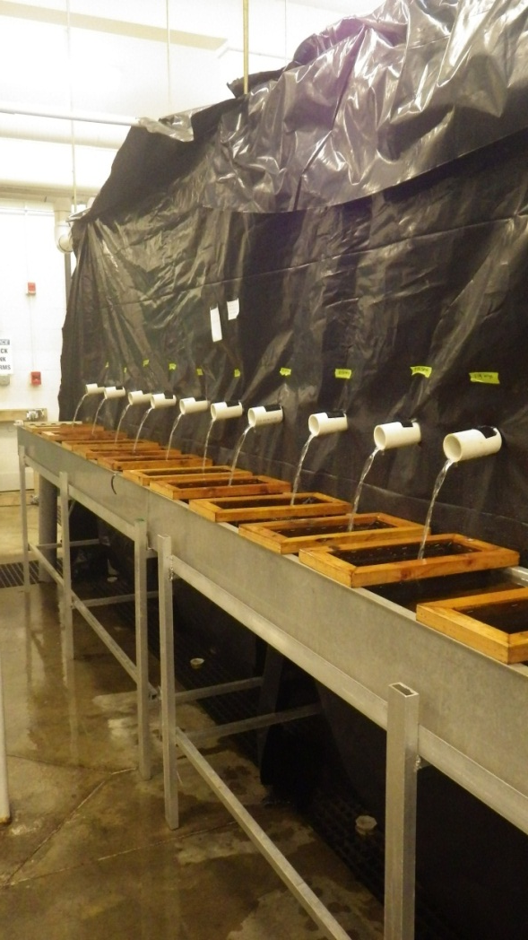
  Early life history
Egg size
Emergence timing

Slide 36
Natural migration life history
Fall
Spring
Rear fish using naturally predisposed growth trajectory
N D J F M A M J J A S O N D J F M A M

Slide 37

  Thank You
  Questions?

